Slide 1
Chapter 2: Empirical Modeling
Chapter 2: Empirical Modeling
EE4265 Tutorial Solutions

Slide 2
Chapter 2: Empirical Modeling
Q1
Input is flowrate in ^{gals} = Q
increased from 500 to 540 ^{gal} at 3.05am.
Output is temperature in ◦F = T
increases from 120◦ F to 124.7◦ F .
first change is at 3.09am. No change after 3.34am.
The description (given) of the step response implies that we can model the system as FOPTD
T ⁰ (s ) K
Q ⁰ (s ) τ s + 1
min
min
=
e ^{−Ls}

Slide 3
Question 1
Q1 - Calculate Parameters
T (∞) − T (0)
124.7 − 120
◦F
K =
=
= 0.118
∆Q
540 − 500
^{gal}/min
L = 3.09 − 3.05 = 4mins
5τ = 3.34 − 3.09 = 25 min
∴ τ = = 5 min
25
5

Slide 4
Chapter 2: Empirical Modeling
Question 1
Q1 - Why 5τ ?
What is the Time at which the step response of the FOPTD
system reaches 99.5% of steady state?

Slide 5
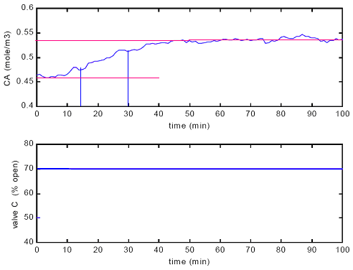
Q2 (b) - Two Point Method
δ = 20%, ∆ = 0.08 ^{mol}
m³
mol
^{∴ 0.63∆ = 0.05} m ³
mol
&0.28∆ = 0.0224
m ³

Slide 6
Q2 (b) - step response tests
t63% = 30min , t28% = 14min .

Slide 7
Q2 (b) - step response tests
Fact
∆ 0.08 mols
δ 0.2 m ³ × %open
τ = 1.5 × (t_{63%} − t_{28%} ) = 24min
L = t_{63%} − τ = 6min
K =
=
= 4 × 10⁻³

Slide 8
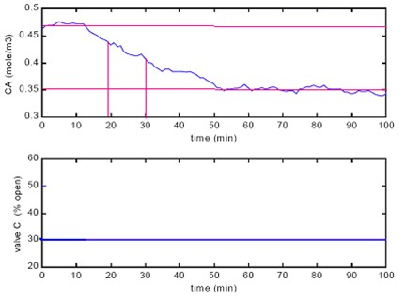
Q2 (b) - step response tests
δ = −20%, ∆ = −0.12 ^{mol}
m³
mol
^{∴ 0.63∆ = −0.0756} m ³
mol
^{&0.28∆ = −0.0336} m ³

Slide 9
Q2 (b) - step response tests
t63% = 30min , t28% = 19min .

Slide 10
Q2 (b) - step response tests
Fact
∆ −0.12 mols
τ = 1.5 × (t_{63%} − t_{28%} ) = 16.5min
L = t_{63%} − τ = 13.5min
K = =
= 6 × 10⁻³
δ −0.2
m ³ × %open

Slide 11
Q2 (c) (d ) - step response tests
Why are the two estimates different?
Indicates that the system is a Non-Linear system.
How does one verify that the models obtained are valid?
Bring the system back to original SS.

Slide 12
Q2 (a ) - critique the experiment
Is the input signal nearly a perfect step?
Are the assumptions about the output behaviour valid? (We usually assume smooth, S-shaped curve)
Did the process begin at steady state? Is the SNR large enough?

Slide 13
Q3
G1 (s ) =
K1
, G2 (s ) =
K2
, τ1 = 5, τ2 = 3
τ1 s +1
τ2 s +1
G = G1G2
(a ) Overall Gain is K₁K₂ = K
(c) It cannot have oscillations. Why?

Slide 14
Q3 (b)
Intent of the question:
K
K
Is G1G2 =
?
(τ s + 1) (τ s + 1) (τ + τ ) s + 1
≈
2
1
1 2
Fact
For a FOPTD system with gain K and time constant τ1 + τ2, the
process reaches 63.2% of steady state at time t = τ₁ + τ₂.
τ₁ +τ₂
y (t ) = KM 1 − e ⁻
t
KM
(1 − e ⁻¹ )
y (t = τ1 + τ2)
= 1 − e ⁻¹ = 0.632
=
KM (1 − e ^{− τ}1 ^{+τ}2 )
y (t = ∞)
∞
where M is the step magnitude.

Slide 15
Q3 (b)
The actual response of the system G = G1G2 to a step M
is,
t
t
τ₁e ^{− τ}1 − τ₂e ^{− τ}2
y (t ) = KM
1 −
τ − τ
1 2
Percentage of SS reached when t = τ1 + τ2 = 8 is,
y (t = 8)
8
8
5e ⁻ 5 − 3e ⁻ 3
= 1 −
= 0.599 = 0.632
y (t = ∞)
2
So, τ1 + τ2 is not the equivalent time constant.

Slide 16
Q4 - Given Data
Initial Flow Rate 30.4 ^{ft 3} , increased by 10%. The output recorded
min
at different times is:
Time (min)
f (ft)
Time (min)
f (ft)
0
5.50
1.4
6.37
0.2
5.75
1.6
6.40
0.4
5.93 (typo in QP)
1.8
6.43
0.6
6.07
2.0
6.45
0.8
6.18
3.0
6.50
1.0
6.26
4.0
6.51
1.2
6.32
5.0
6.53
Model of the system is:
K
G (s ) =
τ s + 1

Slide 17
Q4
Time (min)
f (ft)
Time (min)
f (ft)
0
5.50
1.4
6.37
0.2
5.75
1.6
6.40
0.4
5.93
1.8
6.43
0.6
6.07
2.0
6.45
0.8
6.18
3.0
6.50
1.0
6.26
4.0
6.51
1.2
6.32
5.0
6.53
Process gain is,
6.53 − 5.50
min
K =
= 0.3388
30.4 × 1.1 − 30.4
ft ²

Slide 18
Q4(a ) - from
t63.2%
Time (min)
f (ft)
Time (min)
f (ft)
0.6
6.07
2.0
6.45
0.8
6.18
3.0
6.50
Height at 63.2% is,
h63.2% = 0.632 × (6.53 − 5.50) + 5.50 = 6.145ft
τ
= t63.2% .
We interpolate to find t63.2% :
τ = t_{63.2%} = 0.7364min

Slide 19
Q4(b ) - from initial slope
Time (min)
f (ft)
Time (min)
f (ft)
0
5.50
1.4
6.37
0.2
5.75
1.6
6.40
slope at t = 0:
5.75 − 5.50
ft
m =
= 1.25
0.2 − 0
min
The equation of the tangent is y = mt . When y = K × M , t = τ .
KM 0.3388 × (30.4 × 0.1)
τ =
=
= 0.8240min
m
1.25

Slide 20
Q4(c) - log method
slope of t vs z is − ¹ .
τ
h (∞) − h (t )
z = ln
h (∞) − h (0)
Time (min)
f (ft)
z
Time (min)
f (ft)
0.4
5.93
-0.55
1.8
6.43
0.6
6.07
2.0
6.45
0.8
6.18
3.0
6.50
-3.93
Slope is,
−3.93 − (−0.55)
1
= −
m =
3 − 0.4
∴ τ = 0.8679min
τ

Slide 21
Q4(d )

Slide 22
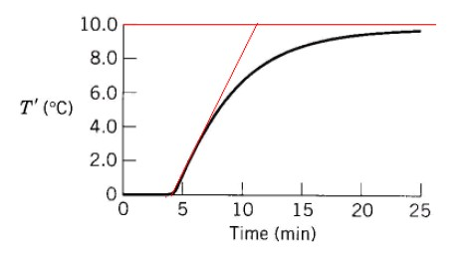
Q5 - Heat Exchanger Model
(a ) use process reaction curve method
10
G (s ) =
e ^{−4s}
6s + 1

Slide 23
Q5 (b)
(b)
G (s ) = GHE (s ) Gpipe (s ) GTC (s )
Pipe Model
3 1
G_{pipe} (s ) = e ^{−θs} , θ = × = 0.1min
0.5 60
Thermocouple (assume unit gain)
GTC (s ) = 1
Heat Exchanger
10
3.9s
GHE (s ) =
e ⁻
6s + 1

Slide 24
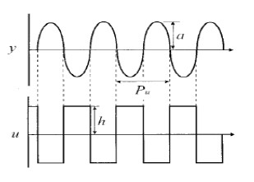
Q6 - Relay Test Method
2π 2π
The ultimate frequency ωu = = = 0.6283
Pu
10
=
4h 4×0.1
0.4
The ultimate gain Ku = =
= 0.4244
πa π×0.3
0.9425
L is taken from the first switching time. L = 3.2s

Slide 25
Q6
The time constant τ :
tan (π − ω_{u} L)
2.1251
τ =
=
= 3.3822
ωu
0.6283
and the process gain K :
(τ ω_{u} )² + 1
5.5161
√
√
K =
=
= 5.5338
Ku
0.4244
The estimated model is:
K
e ^{−Ls}
5.5338
e ^{−3.2s}
G (s ) =
=
τ s + 1
3.3822s + 1

Slide 26
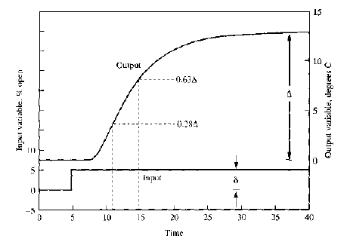
Q7 - Two points method
∆
13
◦C
K = = = 2.6
δ 5
%open

Slide 27
Q7 - Two points method
0.63∆ = 8.5◦ C
0.28∆ = 3.5◦ C
t63% = 15 − 5 = 10min
t_{28%} = 11 − 5 = 6min
τ = 1.5 (t63% − t28% ) = 6min
L = t_{63%} − τ = 10 − 6 = 4min
The model is,
2.6e ^{−4s}
Gp (s ) =
6s + 1

